Slide 1
Improvisation of DaTING APPLICATION using “Java Spring” SERVICEs
Capstone Project Proposal submitted to
Dr. Hiral Shah
Dr. Ben Baliga
By RAkesh Dodla 12536822

Slide 2
Outline
1. Introduction
2. Problem Statement
3. Significance of the Problem
4. Objective of the Project
5. Project Questions
6. Methodology
7. Timeline

Slide 3
Introduction
Accelsoir Inc. is a specialist provider of customized, high-end Business-Technology solutions & services for Insurance, Banking, Manufacturing and Capital markets.
This capstone project proposal will focus on mainly on Dating Application and ensures enhanced release services, where various applications are tested, debugged and modified accordingly in order to meet several business needs and provide outstanding end user experience..
This project involves interaction with the business analysts in order to understand what and how a workflow is considered as critical, and what has to be done to test it in order to meet the desired user experience before an application goes live into production.

Slide 4
Problem Statement
The business area for Accelsoir Inc. is providing IT services to various markets. The current applications was not so effective in achieving the desired response times as expected by the customers which resulted in reduced clientele.
In most of the cases the clients were dissatisfied by fake profiles which were creating an insecurity to the other clients.
The programing code has security breaches.
(Multiple Profiles created and underage)

Slide 5
SIGNIFICANCE of the problem
The applications that was in the production were facing issues like creating fake profiles to lure users in is allegedly widespread practice in the online dating industry and there were many underage kids using these applications.
Un-responsiveness of a few applications due to high user volumes has become a hassle in the production, where downtime of an application during a critical period can result in a loss of business, thereby resulting in a revenue downfall

Slide 6
OBjective
To create a web based application to the socially vulnerable, isolated people above age 18.
To maintain the site, the chat history and validate age of the client by checking ID.

Slide 7
Project questions
1. Will the New Java Spring tool help in saving the cost?
2.How Will You Evaluate the Success of the Application?
3.How might your Application evolve over time?
4.What is the % efficiency increased?

Slide 8
DEFINITION OF TERMS
SQL: Structured Query Language is a special-purpose programming language designed for managing data held in a relational database management system (RDBMS), or for stream processing in a relational data stream management system (RDSMS).
Angular JavaScript is an open-source web application framework mainly maintained by Google and by a community of individuals and corporations to address many of the challenges encountered in developing single-page applications.
Spring Framework is an application framework and inversion of control container for the Java platform. The framework's core features can be used by any Java application, but there are extensions for building web applications on top of the Java EE platform.

Slide 9
LITERATURE REVIEW
The Dating Application focus on connecting friendship that would assist them to establish solid and real connections; easing the isolation and loneliness of the target group and thus improving the quality of their life.
The Validation is done to avoid fake profiles and underage users.
The software is designed to deal with all the data base connections and maintain chat history.

Slide 10
Literature REVIEW Cont..
Database Tier :The data spread across a number of distributed server clusters.
User Tier: Applications and integration for approved clients will be produced to guarantee access through the greater part of today's interfaces - autonomous of working framework. All they require is a web program that is either cross stage or particular to a stage
System interface technology :The framework was created as an intuitive component between the client at the interface and the database utilizing the web-program. This apparatus empowers a client through a web program to interface with the MYSQL database to enter, alter, view and recover such information according to the benefits allowed. HTML structures offer the best format to enter information, change and perspective the database.

Slide 11
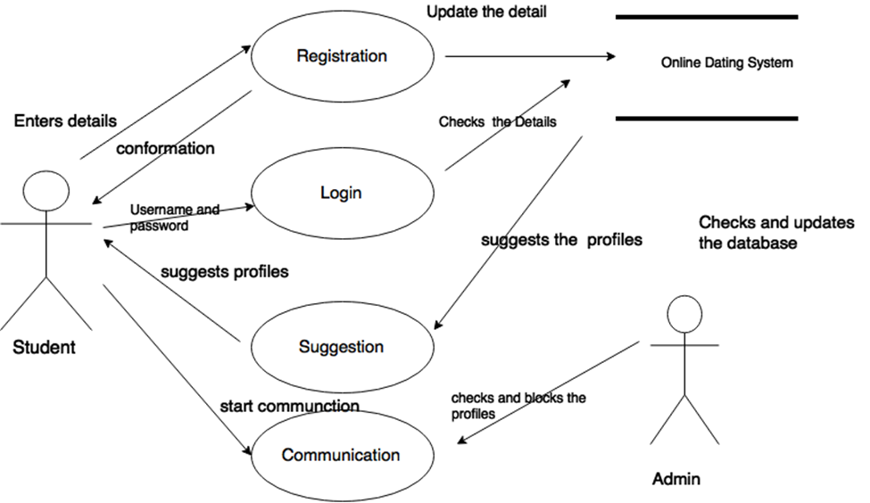
Preliminary process model

Slide 12
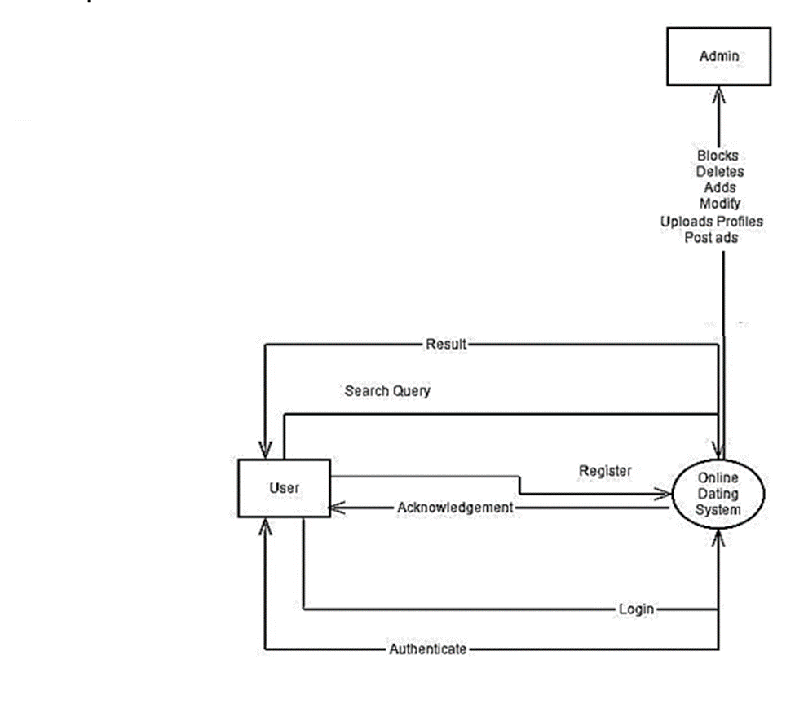

Slide 13
Methodology
Product Vision
Product Road Map
Release Plan
Sprint Plan
Final Deployment

Slide 14
TIMELINE
Activity | Timeline | Comments
Product Vision | April 2016
Product Road Map | May 2016 – July 2016
Release Plan | July 2016 – August 2016
Sprint Plan | September 2016
Final Deployment | September 2016
Final Defense presentation | November 2016

Slide 15
THANK YOU

